Slide 1
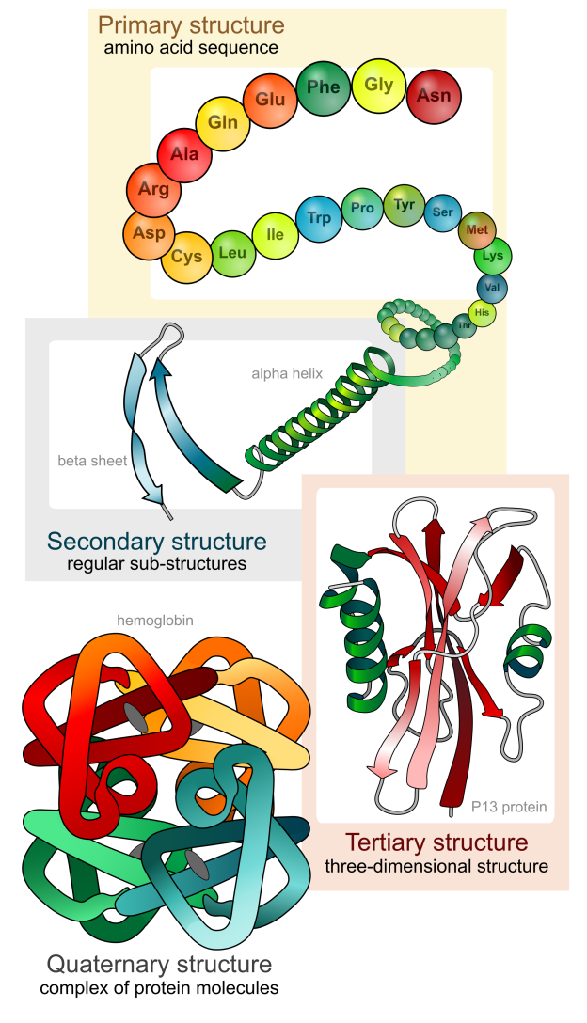
Gene Structure, Splicing
Lecture – 3
Department of CSE, DIU

Slide 2
CONTENTS
Gene Structure
Central Dogma
Protein
Gene Regulation and Alternative Splicing
Miscellaneous Terms

Slide 3
1. Gene Structure
A basic structure of Eukaryotic Gene

Slide 4
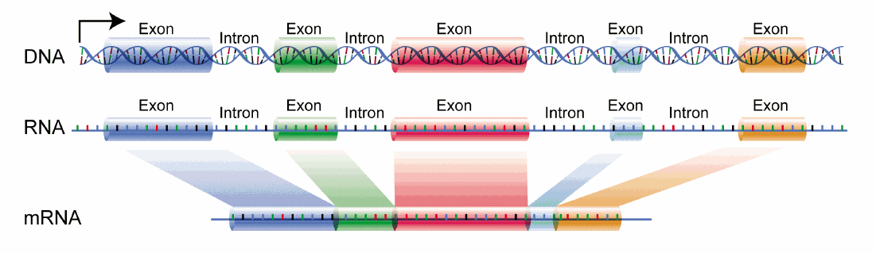
Eukaryotic Gene Structure
Two major parts – Exon & Intron
Exon – Takes part in protein coding and production
Intron – Does not take part in protein coding, part of pre-mRNA but gets filtered out in matured mRNA

Slide 5
2. Central Dogma
Producing Protein from DNA

Slide 6
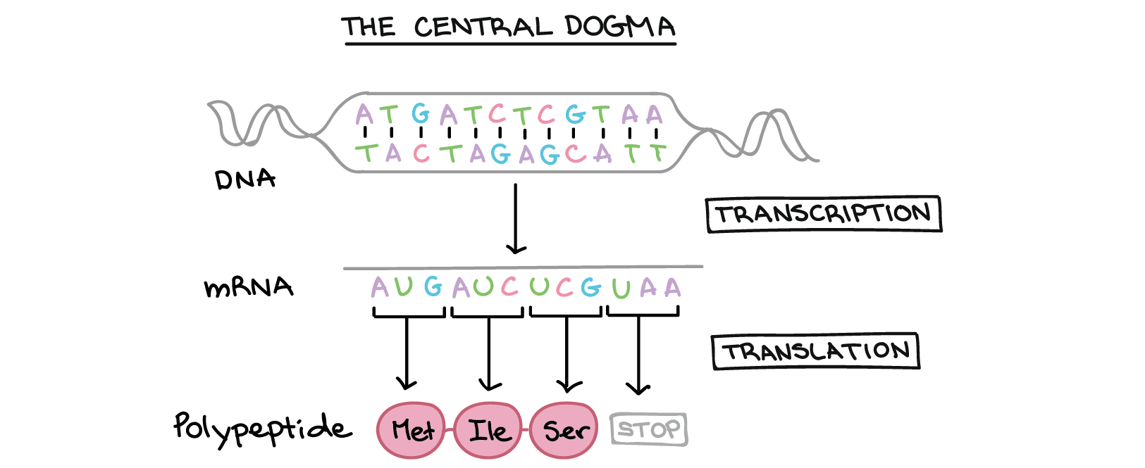
Major Steps of Central Dogma
Transcription
- RNA Polymerase enzyme attaches to the start of the gene
- mRNA is created (complimentary to DNA strand RNA Polymerase is attached) - mRNA is processed, unnecessary sections are removed (introns)
- mRNA moves out of nucleus into cytoplasm
Translation
- mRNA binds to Ribosome
- Ribosome reads code in mRNA (triplets/codons)
- tRNA brings Amino Acid corresponding to codon
- Chain of Polypeptide / Amino Acid is formed
- Chain folds in different 3D shapes and produces different types of Proteins

Slide 7
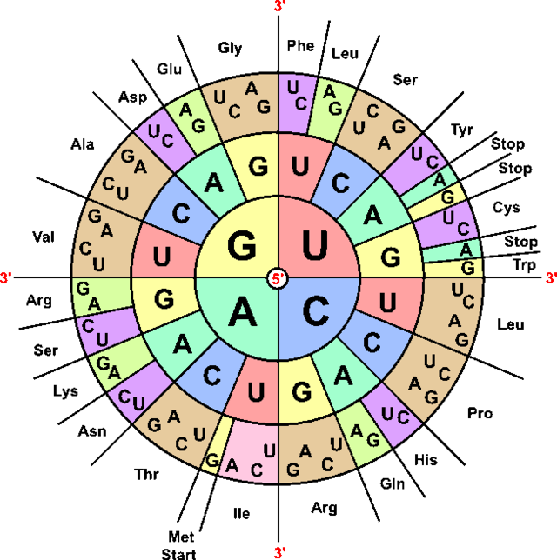
Genetic Codes in Translation (Codons)
Start Codon – AUG
Start Codon codes Methionine
Stop Codon – UAA, UAG, UGA
64 Combinations Possible
20 Amino Acids
More than 1 combination can code single Amino Acid (Ex – UUU, UUC both codes -Phe-)

Slide 8
3. Protein
3D Structure with different formation of Amino Acid chain

Slide 9
Protein Overview
Chains of 20 types of Amino Acid
Performs most of the cell functions
- Regulates gene expression
- Acts as enzymes which catalyze chemical reactions
- Forms structures
Folds into 3 dimensional structures
Function of a protein is determined by its structure

Slide 10
4. Gene Regulation and Alternative Splicing
Study different gene regulations and splicing method

Slide 11
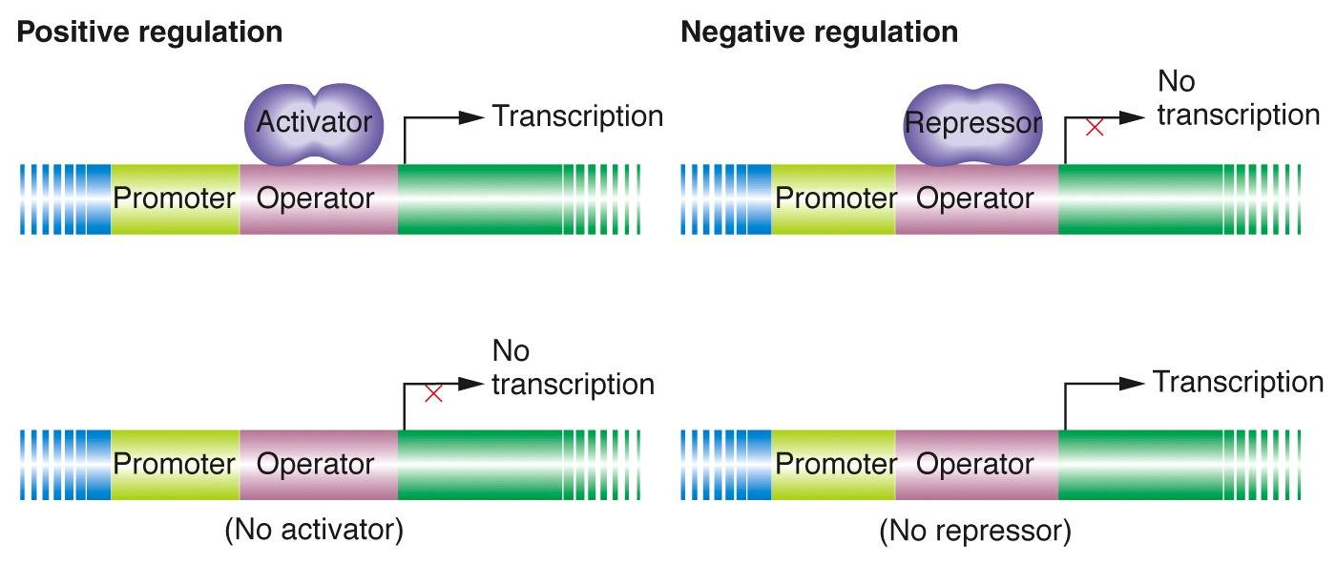
Regulating Gene Expression
Gene regulation refers to the mechanism of inducing or repressing the expression of a gene
2 types of regulation – Positive & Negative
Positive Regulation works with Activator
* Operator + Activator = Transcription
* Operator – Activator = No Transcription
Negative Regulation works with Repressor
* Operator + Repressor = No Transcription
* Operator – Repressor = Transcription

Slide 12
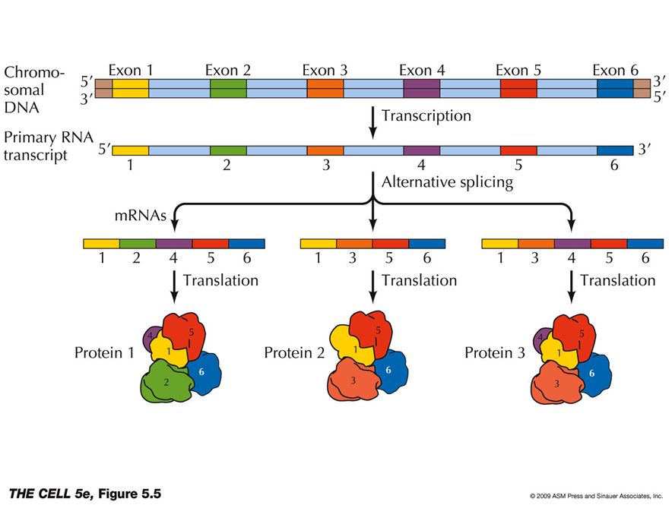
Alternative Splicing
DNA has genes
Genes has regions – Exons & Introns
Pre-mRNA has both introns and exons
Matured mRNA has only exons
Different combinations of exon regions form different protein, this is alternative splicing
Alternative Splicing is the process in which one gene produces many different proteins

Slide 13
5. Miscellaneous Terms
Some comparisons, terms etc.

Slide 14
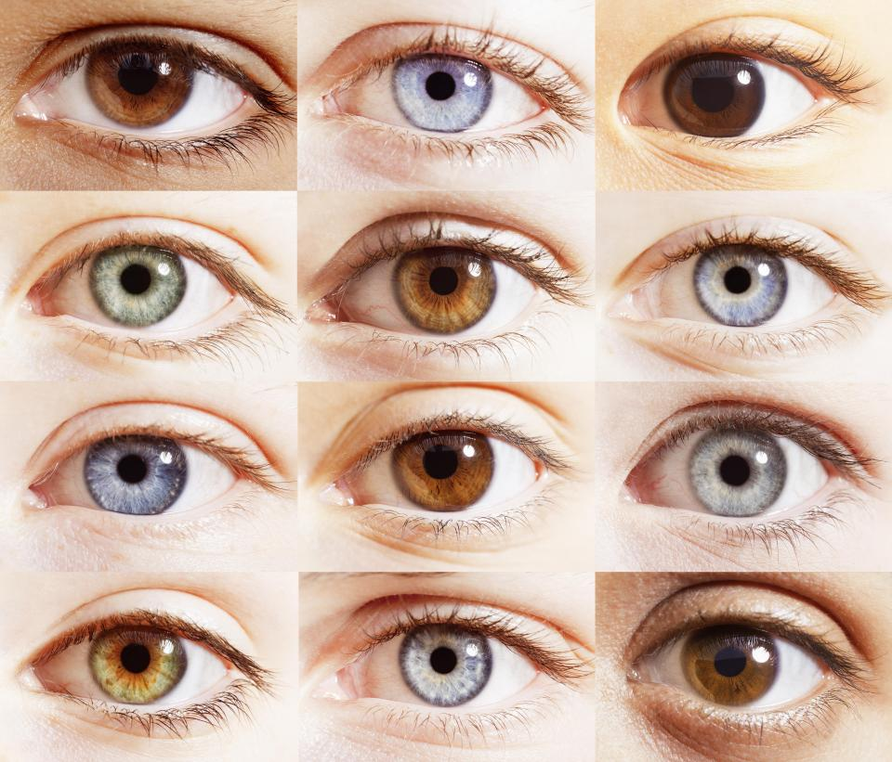
Phenotype VS Genotype
Phenotype is the physical expression of a gene
Genotype is the genetic structure
Example – Eye color is phenotype, and the gene responsible for eye color is genotype.
genotype + environment → phenotype
genotype + environment + random-variation → phenotype

Slide 15
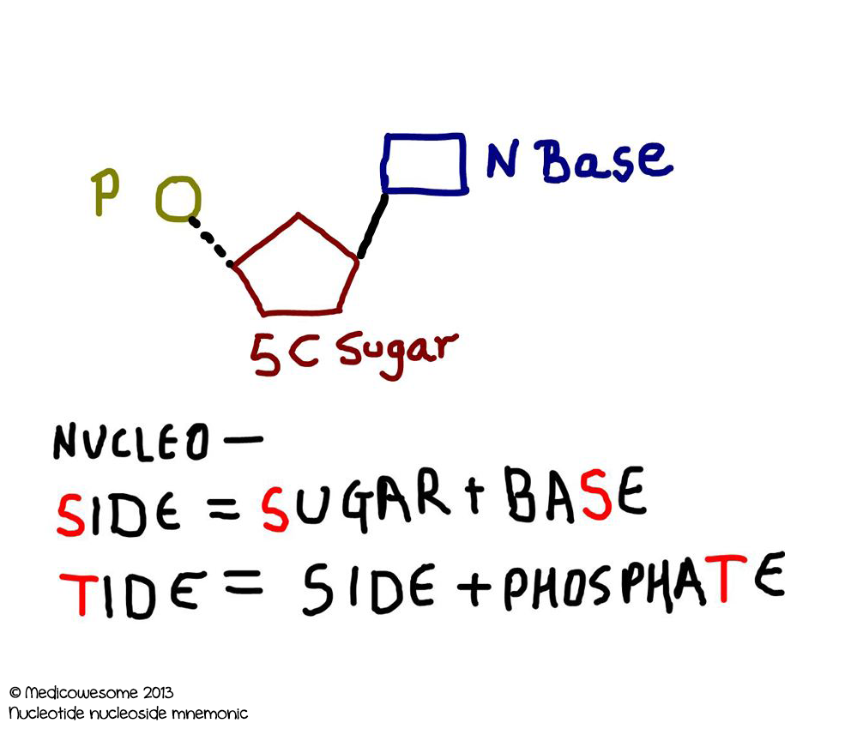
Nucleotide VS Nucleoside
Nucleoside = Base + Sugar
Nucleotide = Base + Sugar + Phosphate

Slide 16


